Slide 1
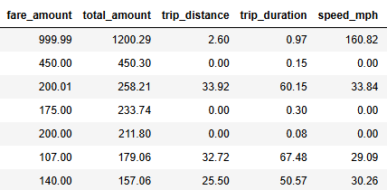
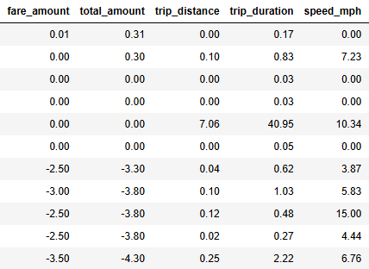
New York City TLC Project Initial Data Summary
Executive Summary Report
Prepared by Automatidata
The dataset provided by the New York City TLC has been successfully loaded, cleaned, and prepared for analysis. It contains historical records of yellow taxi trips, including details such as pickup and drop-off times, trip distances, passenger counts, and fare amounts. This data will serve as the foundation for developing a predictive model to estimate taxi fares prior to a ride.
The objective at this stage was to build a clean and usable dataframe, examine the structure and types of the data, identify any issues, and prepare the dataset for exploratory analysis and future model development.
The dataset is now organized and includes a calculated trip_duration and speed_mph field based on pickup and drop-off timestamps. Column names were standardized, and data types were properly updated. Some data entries contain unusual values such as zero passengers, extremely short or long trip durations, or questionable fare amounts. These records have been noted for further cleaning. Key variables for future modeling include fare_amount, trip_distance, and trip_duration.
The next steps involve filtering out invalid records, exploring patterns and relationships between variables, and preparing the data for use in building a regression model to estimate fares.

Slide 2
Title
Subtitle
Project Overview
Image Alt-Text Here

Slide 3
Title
Subtitle
Image Alt-Text Here
Image Alt-Text Here

Slide 4
Title
Subtitle
Image Alt-Text Here

Slide 5
Title
Subtitle

Slide 6
Title
Subtitle
Image Alt-Text Here

Slide 7
Title
Subtitle

